Slide 1
Unit 3: Advanced Materials
Composite Materials
Introduction, Classification: properties and applications of
Polymer Matrix Composites,
Metal Matrix Composites,
Ceramic Matrix Composites,
Carbon–Carbon Composites,
Fiber- Reinforced Composites and Applications.
Reinforcements
Properties and applications of (Glass), Kevlar, (Carbon), silicon carbide, boron carbide, (Fibers.) (delete glass, carbon and fibres)
Industrial Polymers
Thermoplastics, Thermosetting Plastics, synthesis properties and applications of - LDPE, HDPE, UHDPE, Bakelite, Polymers used in electronic industries- examples and applications of insulating materials, conducting polymers, adhesives, Polymers in optical media data storage devices- principle of optical storage, examples and applications

Slide 2
ADVANCED MATERIALS
An advanced material can be defined as any new or significantly improved material that provides a distinct advantage in (physical or functional) performance when compared to conventional materials.

Slide 3
Introduction
There is an unabated quest for new materials which will satisfy the specific requirements for various applications.
e. g. structural, medical, house-hold, industrial, construction, transportation, electrical; electronics, etc.
Metals are the most commonly used materials in these applications.
There have been specific requirements on the properties of these materials. It is impossible of any material to fulfill all these properties. Hence, newer materials are developed.
In the course, we are going to learn more about composite materials. First, we will deal with primary understanding of these materials and then we will learn the mechanics of these materials.

Slide 4
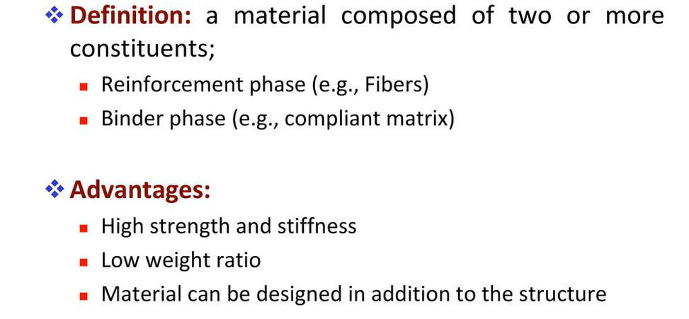
Composite materials

Slide 5
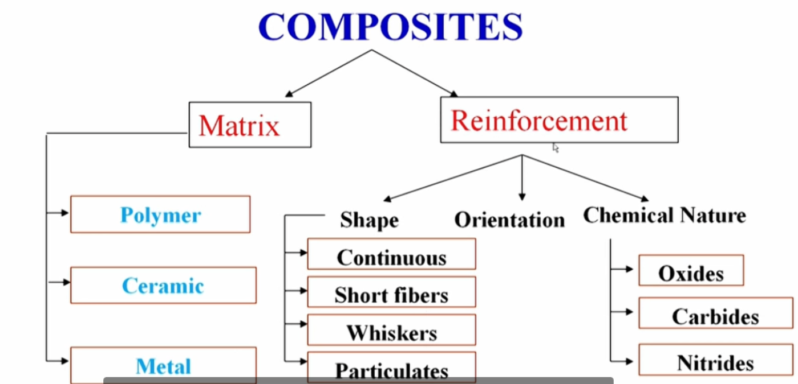
Classification of Composite

Slide 6
POLYMERS IN ELECTRONICS
There are three very broad areas of polymer and composite material use in electrical and electronics applications.
Different sets of properties are of the greatest importance in each of these three areas of use.
Some properties are considered to be important in all use areas.
Important applications are as follows
I)Electrically insulating polymers
II)Intrinsically conducting polymers
III)Adhesives, coatings, potting compounds, and sealants polymers.

Slide 7
Insulating materials
The substances which are capable of retarding or prohibiting the flow of heat or electricity or sound through them are known as Insulators or Insulating Materials.
Insulators can be broadly classified
Thermal Insulator
Electrical Insulator
Sound Insulator
Electrical Insulating materials
Properties:
(a) A good insulator possesses low electrical conductivity or high resistivity. Typical values being 10⁹ to 10²⁰ ohm-cm at room temperature.
(b) Dielectrics used in capacitor should have high dielectric constant so that greater amount of energy can be stored in relatively thin insulation.
A good electrical insulating material should have a low dielectric constant. Dielectric constant is the capacity or ability of a material to store charge.
(c) An ideal dielectric is that which does not absorb electrical energy and the charge of capacitor is completely recovered when the electrical field is removed.
An ideal insulator should have minimum dielectric losses. In an insulating material dielectric loss is caused by The absorption of electrical energy (internal dipole friction) and Leakage of current through the material.

Slide 8
(d) Good dielectric materials should have low porosity.
This is due to the fact that higher porosity increases the moisture holding capacity and moisture adversely affects the electrical properties.
(e) An ideal insulator should have least thermal expansion and contraction.
(f) Good insulating materials should be chemically inert to acids, alkalies, oils, solvents, moisture, gas fumes etc.
Polymers as insulators
Insulators | Note | Application
Polyethylene | Has dielectric constant of 2.3. At radio frequencies, it has low electrical losses. | Used for semi-flexible, high frequency, coaxial cables. It is also used as high frequency insulator in radio, television and communication circuit cables. Also used in power and submarine cables.
Polystyrene | It has dielectric constant of 2.8, excellent dielectric properties, low moisture absorption, good dimensional stability. | Used as dielectric in D.C., high frequency capacitors, electrical bushings, telephones, fluorescent light accessories etc.

Slide 9
Insulators | Note | Application
Teflon | Ideal dielectric with dielectric constant of 2 to 2.2. Most thermally and chemically stable, can be applied as insulant upto 327 °C. | Used as capacitor dielectrics and insulating material for almost all kinds of windings.
Polyvinyl chloride | It is chemically inert, mechanically strong, has extremely low moisture absorption property, has dielectric constant of 3-3.3 and most widely used plastic for insulation purposes. | Used in flexible wire coverings, cable sheathings, insulating electric wires and low voltage cables.
Epoxy Resins | Possess excellent electrical and mechanical properties | Widely used in making insulators, bushings etc., for high voltages. Also used for making laminates and insulating varnishes.

Slide 10
Insulators | Note | Application
Polyester resins | Possess good dielectric properties and highly resistant to most acids, bases, salts and solvents. | Used in making paper, cloth mat for electrical insulation. Its films are used for wire and cable insulations and in motors, transformers and capacitors.

Slide 11
Adhesives
An adhesive can be defined as "any substance capable of holding materials together by surface attachment". The bodies held together by an adhesive, are known as adherends; while the process of holding one adherent to another by adhesive, is called bonding and the final assembly of two adherends and the adhesive is called bond or joint.
The quality of an adhesive is judged by: (i) degree of tackiness (i.e., stickiness), (ii) rapidity of bonding, (iii) strength of bond setting on drying and (iv) durability.

Slide 12
Materials | Applications
Adhesives: Epoxy, acrylate, epoxy acrylate, urethane, urethane acrylate, cyanoacrylate, siicones | The most important use of adhesives is in the assembly of the printed circuit board (PCB) which is the basic building block of the electronics industry. A typical PCB consists of a multi-laminate reinforced polymer board (most often a glass fiber reinforced epoxy thermoset matrix) with a protective plastic coating (permanent solder mask). PCB assembly also makes use of adhesive materials in bonding surface-mount components (SMCs), wire tacking, conformal coatings, and potting and encapsulating components. Epoxy is the acceptable material of lowest cost that can be used for the solder mask. Acrylate, epoxy, and urethane acrylate adhesives are used for bonding SMCs.
Adhesives: Polyimide | Polyimide adhesives are used for high-technology electronics applications and able tolerate temperatures of up to 300 ºC. Examples include wire coatings and flexible circuits used in aerospace applications.

Slide 13
Materials | Applications
Adhesives: Electrically conductive | The adhesives listed above are not electrically conductive. Some applications, such as integrated circuits and surface mount devices, require electrically conductive adhesives. An electrically conductive adhesive is usually obtained by adding a conductive filler (such as silver,carbon) to a base material (most often an epoxy resin).
Adhesives: Thermally conductive | Miniaturized electronic circuitry may build up heat and fail if its maximum operating temperature is exceeded. Thermally conductive adhesives are used to prevent such heat buildup. A thermally conductive adhesive is obtained by blending a metallic (electrically conductive) or non-metallic (electrically insulating) powder into a base material (most often an epoxy, silicone, or acrylate).

